Slide 1
Big Mountain Resort
New chair lift cost recoup project

Slide 2
Problem Identification
The Resort has recently installed additional chair lift, which increased their operating costs by $1,540,000 this season.
The goal of this project is to find a solution to maintain business profit margin at 9.2% after the addition of the new chair lift.

Slide 3
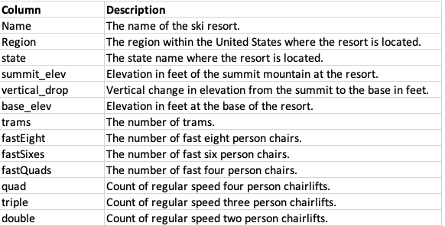
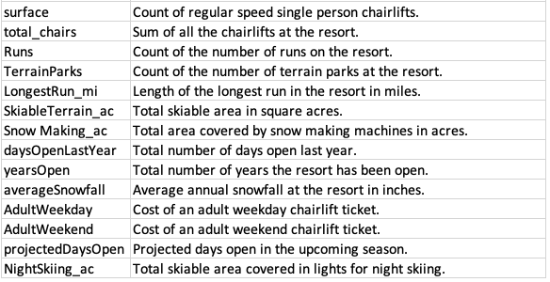
Analysis
The data provided contains the following information
And there were total of 266 resorts across U.S. in the data.

Slide 4
Title and Content Layout with Chart

Slide 5
Two Content Layout with Table
First bullet point here
Second bullet point here
Third bullet point here
Class | Group A | Group B
Class 1 | 82 | 95
Class 2 | 76 | 88
Class 3 | 84 | 90

Slide 6
Two Content Layout with SmartArt
First bullet point here
Second bullet point here
Third bullet point here
Group A
Task 1
Task 2
Group B
Task 1
Task 2
Task 3
Task 4
Task 3

Slide 7
Add a Slide Title - 1

Slide 8
Add a Slide Title - 2

Slide 10
Add a Slide Title - 4

Slide 11
Add a Slide Title - 5

